Slide 1
Goals of this Section
To understand the implementation of linked lists
We will write our own version of LinkedList
Notes:
Implementing Singly Linked List

Slide 2
Lists of (references to) objects can be stored in an array or an ArrayList
ArrayList overcomes the limitations of the fixed size array, but resizing requires much shifting of elements
Both structures are inefficient at inserting and deleting items in the list
Insertion and deletion operations require shifting elements back and forth within the array

Slide 3
Using Linked Lists
A linked list overcomes these limitations
A linked list consists of a number of nodes, each of which has a reference to the next node
A linked list grows dynamically – i.e. memory is allocated for a node only when required
Then as the elements will not occupy contiguous memory locations, they must be linked together
Each node in the linked list contains data fields and a reference to the successor node.
The last node has a reference value null

Slide 4
Adding and removing elements in the middle of a linked list is efficient
Visiting the elements of a linked list in sequential order is efficient
Random access is not efficient
Compare this with array/ArrayList

Slide 5
Implementing Linked Lists
Java has a LinkedList class in java.util
First, we will look at the implementation of a simplified version of this class
It will show you how the list operations manipulate the links as the list is modified
To keep it simple
  we will implement a singly linked list
  and it will have a reference to first node only – NOT to last node
Notes:
Implementing Singly Linked List

Slide 6
We will have two classes:
  Node class is used to represent the data type for an individual list node – an inner class
  CP3LinkedList class represents the overall list which is a chain of nodes
Notes:
Recall we have seen the use of inner classes for event handlers. Inner classes are useful in that context because their methods have the privilege of accessing data members of outer-class objects.
The Link class here does not need to access the outer class. In fact it has no methods. Thus there is no need to store a reference to the outer List class with each Link object. To suppress the outer-class reference, you can declare the inner class as static i.e.
private static class Link ….
Using inner private classes for GUI stuff:
public class ButtonFrame2 extends JFrame
{
private JButton button;
private JLabel label;
private static final int FRAME_WIDTH = 300;
private static final int FRAME_HEIGHT = 100;
public ButtonFrame2()
{
createComponents();
setSize(FRAME_WIDTH, FRAME_HEIGHT);
}
private class ClickListener implements ActionListener
{
public void actionPerformed(ActionEvent event)
{
label.setText("I was clicked.");
}
}
private void createComponents()
{
button = new JButton("Click me!");
ActionListener listener = new ClickListener();
button.addActionListener(listener);
label = new JLabel("Hello, World!");
JPanel panel = new JPanel();
panel.add(button);
panel.add(label);
add(panel);
}
public static void main(String[] args)
{
JFrame frame = new ButtonFrame2();
frame.setDefaultCloseOperation(JFrame.EXIT_ON_CLOSE);
frame.setVisible(true);
}
}
Implementing Singly Linked List

Slide 7
Implementing Linked Lists
CP3LinkedList will supply direct access only to the first list element, not the last one
Node: stores an object and a reference to the next node
Methods of linked list class have frequent access to the Node instance variables
To make it easier to use:
  We do not make the instance variables of Node private
  We make Node a private inner class of CP3LinkedList
  It is safe to leave the instance variables public
    None of the list methods returns a Node object
Notes:
public/private/protected are called “access modifiers”
Implementing Singly Linked List

Slide 8
Implementing Linked Lists
public class CP3LinkedList<E>
{
private class Node
{
public E data;
public Node next;
}
}
Notes:
To implement your own generic class, place the type variable after the class name:
public class CP3LinkedList<E> { etc
To instantiate CP3LinkedList, specify the actual type
e.g. CP3LinkedList<String> list = new CP3LinkedList();
Implementing Singly Linked List

Slide 9
Implementing Linked Lists
CP3LinkedList class
  Holds a reference first to the first node
  Has methods
    getFirst (to get the first element )
    addFirst
    removeFirst
    isEmpty
    print (displays the contents of the list)

Slide 10
Implementing Linked Lists
public class CP3LinkedList
{
private class Node
{
public E data;
public Node next;
}
private Node first;
public LinkedList()
{
first = null;
}
public E getFirst()
{
if (first == null)
throw new NoSuchElementException();
return first.data;
}
}

Slide 11
Adding a New First Element (1)
When a new node is added to the list
  It becomes the head of the list
  The old list head becomes its next node
Copyright © 2013 by John Wiley & Sons. All rights reserved.
Page <number>

Slide 12
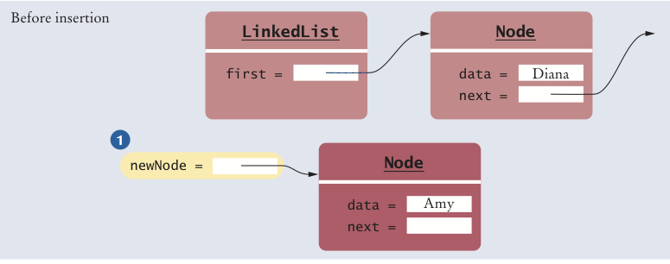
Adding a New First Element (2)
public void addFirst(E element)
{
Node newNode = new Node();
newNode.data = element;
newNode.next = first;
first = newNode;
}
Copyright © 2013 by John Wiley & Sons. All rights reserved.
Page <number>

Slide 13
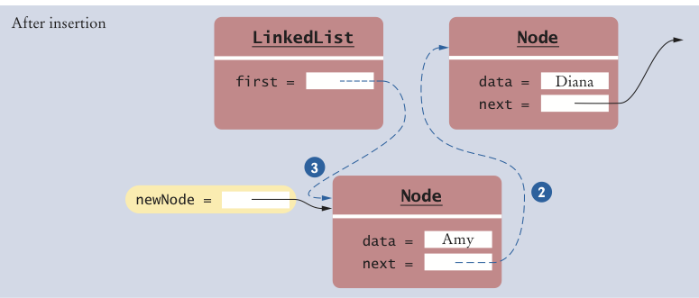
Adding a New First Element (3)
public void addFirst(E element)
{
Node newNode = new Node();
newNode.data = element;
newNode.next = first;
first = newNode;
}
Copyright © 2013 by John Wiley & Sons. All rights reserved.
Page <number>

Slide 14
Removing the First Element
When the first element is removed
  The successor of the first node becomes the first node of the shorter list
  The old node will be garbage collected when there are no further references to it

Slide 15
Removing the First Element
public E removeFirst()
{
if (first == null)
throw new NoSuchElementException();
E element = first.data;
first = first.next;
return element
}
Notes:
If an attempt is made to remove an item from an empty list, a NoSuchElementException is thrown
NoSuchElementException is a class in the Java library
Implementing Singly Linked List

Slide 16
Inserting and deleting in the middle
In our code, have not looked at insertion and deletion in the middle of the list
We would have to implement ListIterator interface for this
Insertion and deletion involve redirecting references – see diagrams
Much more efficient than an array

Slide 17
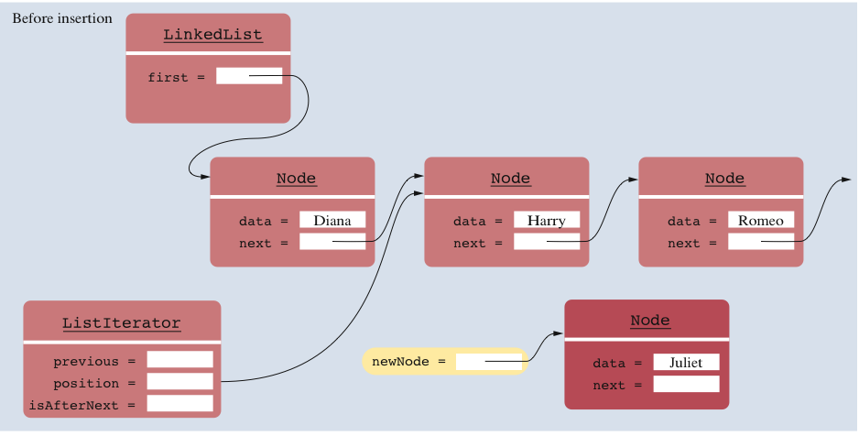
Inserting an Element (1)
Copyright © 2013 by John Wiley & Sons. All rights reserved.
Page <number>

Slide 18
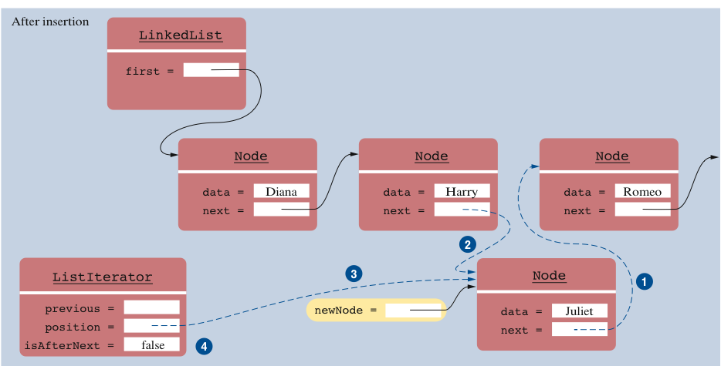
Inserting an Element (2)
Copyright © 2013 by John Wiley & Sons. All rights reserved.
Page <number>

Slide 19
Draw a diagram to show removing an element in the middle of the list

Slide 20
Doubly linked list
We have looked at singly linked list
Doubly linked list:
  each node has two link properties:
    a link to the next node in the list
    a link to the previous node in the list
The singly linked list is efficient for movement forward through the list
The doubly linked list is efficient at both forward and backward processing
Java’s LinkedList is a doubly linked list with references to first and last nodes
Notes:
Example of application where data is to be traversed both backward and forward:
text editor or word processor
During an edit session, store the data file in memory as a doubly linked list - one line of data in each node
Then inserting and deleting lines, backward and forward scans are very efficient operations.
Compare with storing as an array of strings:
wastage of space, since need to declare a very large array
insertions and deletions are inefficient
Implementing Singly Linked List

